Slide 1
NEWER ANTIANGINALS
Dr Muzammil Musthafa
`

Slide 2
Cardiomyocyte metabolism depends on:
ATP SYNTHESIS- which requires oxygen
Required for:
Membrane transporter- NaK ATPase
Excitation contraction coupling : myosin ATP ase and ATP dependent Ca transporter

Slide 3
LCFA(80%) and glucose(20%) –major source of ATP- aerobic
Glycogen-anaerobic
Fetus – main source of energy- GLUCOSE
Shift to FFA—early post natal period

Slide 4
Chronic angina is a condition characterised by impaired QOL and is associated with decreased life expectancy.
Primary symptom of myocardial ischemia
Occurs when oxygen supply is inadequate to meet the myocardial oxygen demand
Tightness , heaviness , squeezing, crunching, pressure sensation
Retrosternally located
+/- radiation

Slide 5
Stable or CSA
Unstable
Prinzmetals/vasospastic/variant

Slide 6
Stable
Narrowing of epicardial coronaries
Atherosclerotic process
Short duration
2-5mts
Aggravating and relieving factors

Slide 7
Unstable
+/_ rest
Rupture of atherosclerotic plaque with superimposed thrombus formation
Severe( crescendo)
Frequency
Duration
More precipitating factors

Slide 8
Vasospastic/variant/prinzmetals
At rest
Severe
Spasm –transient

Slide 9
pathophysiology
Demand supply mismatch
O2 demand>>>> O2 supply

Slide 10
02 demand
Heart rate—major determinant
Contractility
Wall tension
02 supply
Difference of AV oxygen pressure
CBF—duration of diastole, ADP, CVR

Slide 11
Conditions aggravating angina
Increased demand
Thyrotoxicosis
Systemic Hypertension
Valvular heart disease
Catecholamine analogues(bronchodilators, antidepressants,cocaine)

Slide 12
Reduced oxygen supply
Hypoxia
Anemia
CO poisoning
Hypotension
Tachycardia

Slide 13
Oxygen consumption
Arrested heart- 2ml 02/min/100g
Resting heart-8ml /min /100g
exercise-70 ml/min/100g

Slide 14
Despite the advances in medical and interventional therapies a significant number of patients with ischemic heart disease and angina pectoris cannot be successfully managed.

Slide 15
Unsuitable anatomy
One or several prior revascularization procedures
Lack of vascular conduits for CABG
Severely impaired left ventricular function in patients with previous CABG or PCI
Co -morbidities
Age, often in combination with other factors

Slide 16
ANTIANGINALS
Classical agents
Newer agents

Slide 17
Classic agents-modulate hemodynamic effects—hemodynamic agents
Newer agents-improve cardiac metabolism and energy availability—metabolic modulators

Slide 18
HISTORY OF ANTI ANGINAL THERAPY
1867 : NITRATES
1962 : BETA BLOCKERS
1960 : CABG
1977: PCI
1982 : CCBs
2006: RANOLAZINE

Slide 19
EECP
TMR
Exercise training
Non pharmacologic
SCS
Newer anti- anginal strategies
Pharmacologic
Fasudil
Nicorandil
Trimetazidine
Ivabradine
Ranolazine
Notes:
Current nonpharmacologic antianginal strategies
Gibbons RJ, Abrams J, Chatterjee K, Daley J, Deedwania PC, Douglas JS, et al. ACC/AHA 2002 guideline update for the management of patients with chronic stable angina: A report of the American College of Cardiology/ American Heart Association Task Force on Practice Guidelines (Committee to Update the 1999 Guidelines for the Management of Patients with Chronic Stable Angina). 2002. Available at www.acc.org/clinical/guidelines/stable/ stable.pdf.

Slide 20
Cardiac metabolism

Slide 21
Ranolazine
It is a substituted piperazine compound.
1st approved in 2006
pFOX
Late sodium current blocker

Slide 22
Ischemia
↑ Late I_{Na}
Ranolazine
Na⁺ Overload
Ca⁺⁺ Overload
Diastolic relaxation failure
Extravascular compression
Chaitman BR. Circulation. 2006;113:2462-2472
Notes:
Ischemia is associated with disruptions in cellular sodium and calcium homeostasis.
An enhanced late sodium current is likely to contribute to the sodium overload observed in ischemia. Late phase sodium channels have been shown to remain open longer in ischemic conditions. Sodium overload may result from decreased efflux and increased influx during ischemia, with greater intracellular accumulation of sodium as the duration of ischemia increases.
This is followed by an increase in intracellular Calcium through the Na/Ca exchanger on the myocyte wall.
Ju YK, Saint DA, Gage PW. Hypoxia increases persistent sodium current in rat ventricular myocytes. J Physiol. 1996;497 ( Pt 2):337-347.
Murphy E, Perlman M, London RE, Steenbergen C. Amiloride delays the ischemia-induced rise in cytosolic free calcium. Circ Res. 1991;68:1250-1258.
Jansen MA, van Emous JG, Nederhoff MG, van Echteld CJ. Assessment of myocardial viability by intracellular 23Na magnetic resonance imaging. Circulation. 2004;110:3457-3464.

Slide 23
Calcium overload causes diastolic relaxation failure, which:
Increases myocardial oxygen consumption
Reduces myocardial blood flow and oxygen supply(microvascular hypoperfusion)
Worsens ischemia and angina

Slide 24
Ranolazine
Blood Pressure or Heart Rate—not affected
Added with classic agents- refractory symptoms, unable to increase dose of classical agents
Ranolazine has twin pronged action.
pFOX
Late Na inward entry blockade ( MAJOR MECHANISM)

Slide 25
Medication Class | Impact on HR | Impact on BP | Physiologic Mechanism
Beta Blockers |  |  | Decrease pump function
Calcium Channel Blockers |  |  | Decrease Pump function +Vasodilatation(dihydropyrides)
Nitrates |  |  | Vaso-dilatation
Ranolazine | _ | _ | Reduced Cardiac Stiffness
[

Slide 26
Trials

Slide 27
MARISA and CARISA TRIAL
Increased exercise duration
Time to angina episodes
Time to 1mm ST DEPRESSION

Slide 28
ERICA TRIAL
Anginal episodes per week
NTG consumption per week

Slide 29
MERLIN TIMI 36
In ACS ranolazine added to standard therapy was associated with
No difference in:
Composite efficacy endpoint of CV death, MI, reccurent ischemia
Safety endpoints of all cause death, CV hospitalization or symptomatic documented arryhmia.
Significant reduction in arrhythmias detected by Holter in first 7 days.

Slide 30
Contraindications
QT interval prolongation
blockage if Ikr channels
upto 6 ms (may be upto 15ms)
Especially in patients with
Moderate to severe liver disease

Slide 31
metabolized by CYP3A
inhibits CYP2D6
CAUTION WITH CYP3A inhibitors/inducers
Verapamil, diltiazem
Macrolides
Ketoconazole
Nelfinavir
Phenytoin, phenobarbitone, rifampicin

Slide 32
Other beneficial effects
HbA1c reduction
Antiarrythmic effects
(MERLIN TIMI TRIAL)
Heart failure (RALI-DHF TRIAL)

Slide 33
Side effects
Nausea
Dizziness
Asthenia
Constipation
Headache
Doses above 1000 mg twice daily are poorly tolerated.

Slide 34
Sinus node inhibition: Ivabradine
SA node
AV node
Common bundle
Bundle branches
Purkinje fibers
.
Notes:
Ivabradine selectively targets the Na⁺/K⁺ current (I_{f} current) in pacemaker cells of the sinoatrial node.
Channels that carry the I_{f} current are unique to the sinoatrial node, although ion channels in the retina have a similar structure and are probably the source of mild, transient visual disturbances in some patients taking I_{f} blockers.¹
Sinus node inhibition: Ivabradine
Tardif J-C, Ford I, Tendera M, Bourassa MG, Fox K, for the INITIATIVE Investigators. Efficacy of ivabradine, a new selective I_{f} inhibitor, compared with atenolol in patients with chronic stable angina. Eur Heart J. 2005;26:2529-2536.

Slide 35
I_{f} current is an inward Na+/K+ current that activates pacemaker cells of the SA node
Selectively blocks I_{f} in a current-dependent fashion
Reduces slope of depolarization, slowing HR

Slide 36
Trials
INITIATIVE TRIAL
RCT
compared ivabradine (5, 7.5 and 10 mg bid) with atenolol - found to be non inferior.
ASSOCIATE TRIAL
RCT
Ivabradine better than placebo in anti anginal efficacy.

Slide 37
C/I in sick sinus syndrome
Metabolised via CYP3A4 – caution

Slide 38
Luminous phenomenon- sensations of enhanced brightness in a fully maintained visual field
Blockage of Ih channels in retina.

Slide 39
Trimetazidine
Myocytes
FFA
Glucose
Acyl-CoA
Pyruvate
O2 requirement of glucose pathway is lower than FFA pathway
During ischemia, oxidized FFA levels rise, blunting the glucose pathway
β-oxidation
Trimetazidine
Acetyl-CoA
Energy for contraction
.
Notes:
The free fatty acid oxidation hypothesis arose out of advances in understanding of myocardial metabolic pathways.
Myocardial cells derive their energy via fatty acid and glucose metabolism. During ischemia the fatty acid pathway predominates. However, this pathway requires more oxygen than the glucose pathway.¹
Theoretically, inhibition of fatty acid oxidation should promote a shift towards the more oxygen-efficient glucose pathway.
Lopaschuk et al and Stanley have reported experimental data showing that the antianginal trimetazidine is an inhibitor of partial fatty acid oxidation (pFOX). However, MacInnes et al did not observe any inhibition with trimetazidine in other experimental models.
Thus, inhibition of fatty acid oxidation as a major antianginal mechanism for trimetazidine remains to be definitively established.
Metabolic modulation (pFOX): Trimetazidine
Chaitman BR, Skettino SL, Parker JO, Hanley P, Meluzin J, Kuch J, et al, for the MARISA Investigators. Anti-ischemic effects and long-term survival during ranolazine monotherapy in patients with chronic severe angina. J Am Coll Cardiol. 2004;43:1375-1382.

Slide 40
No EFFECT on HR or BP
TRIMPOL II –RCT
Trimetazidine 20 mg three times a day vs placebo in addition to metoprolol 50mg.
Improvement in :
Time to ST segment depression on exercise tolerance testing (ETT),
Decrease in angina frequency

Slide 41
VASCO Trial
Largest RCT
Showed no benefit as an add on in angina

Slide 42
Side effects
Extrapyramidal symptoms
Restless leg syndrome.
CAUTION- Excretion impaired in p/w severe renal impairment.

Slide 43
Perhexilene
Do not affect HR or BP
Multiple randomized trials show that it has anti anginal effect as monotherapy or in combination.
Inhibition of CPT-1 and, to a lesser extent, CPT-2, resulting in increased glucose and lactate utilisation

Slide 44
S/E
Hepatotoxicity
Peripheral neuropathy
Hypoglycemia

Slide 45
Etomoxir/ Oxfenicine
Launched as anti diabetic agent
CPT 1 INHIBITOR

Slide 46
Nicorandil
Activation of ATP-sensitive K⁺ channels
Dilation of coronary resistance arterioles
N
O
HN
O
NO₂
Nitrate-associated effects
Vasodilation of coronary epicardial arteries
Notes:
Nicorandil possesses a nitrate moiety and, therefore, produces hemodynamic effects similar to those of long-acting nitrates.
It activates cyclic GMP (cGMP), dilates capacitance vessels, and decreases preload.
Nicorandil is also capable of opening ATP-sensitive K⁺ (K_{ATP}) channels. These channels are involved in dilation of coronary resistance arterioles, which decreases afterload, and are also thought to mimic ischemic preconditioning, a potential cardioprotective effect.
Preconditioning: Nicorandil

Slide 47
20mg bid
Tolerance
No cross tolerance with nitrates
The Impact Of Nicorandil in Angina (IONA) trial - significant reduction of major coronary events in stable angina patients treated with nicorandil compared with placebo as add-on to conventional therapy
Additive effects with nitrates

Slide 48
Fasudil
Ca²⁺
Ca²⁺
Agonist
Receptor
PLC
PIP₂
Rho
IP₃
Fasudil
Rho kinase
SR Ca²⁺
Myosin
MLCK
Myosin phosphatase
Ca²⁺
Myosin-P
Calmodulin
Notes:
The role of Ca²⁺ in activating myosin light chain kinase (MLCK) and phosphorylating myosin to cause contraction is well known.
Dephosphorylation by myosin phosphatase causes subsequent dilation.
More recently, the involvement of Rho kinase has been identified.
In the absence of increases in intracellular Ca²⁺, Rho (a member of the Ras superfamily of small G proteins) activates Rho kinase, which in turn deactivates myosin phosphatase. This causes accumulation of phosphorylated myosin.
Other abbreviations used in the figure:
IP₃ = inositol triphosphate
PIP₂ = phosphatidylinositol biphosphate
PLC = phospholipase C
ROC = receptor-operated channel
SR = sarcoplasmic reticulum
VOC = voltage-operated channel
Rho kinase inhibition: Fasudil

Slide 49
Fasudil—80 mg TID
Improves angina symptoms

Slide 50
Molsodomine & linsodomine
Acts like nitrates
Orally active

Slide 51
TMLR
Surgical
surgeons use the laser to make holes between 20 and 40 tiny (one-millimeter-wide)
Done along with CABG sometimes

Slide 52
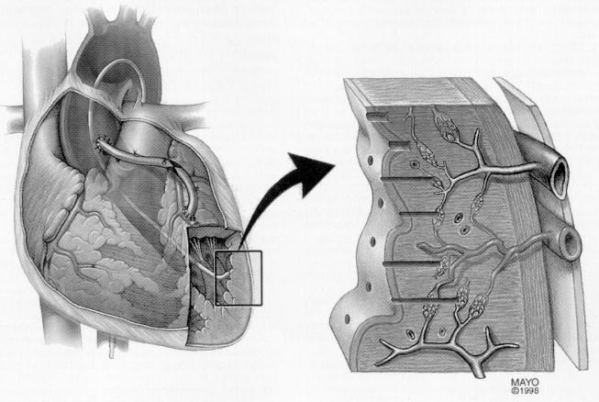
Percutaneous TMR

Slide 53
stimulation of angiogenesis
Anesthetic effect -destruction of sympathetic nerves carrying pain-sensitive afferent fibers

Slide 54
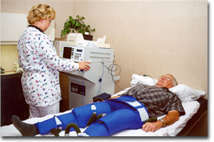
Enhanced external counterpulsation

Slide 55
EECP
Cuffs are wrapped around the patients legs and sequential pressure (300mmHg) is applied in early diastole.
3 pairs of cuffs

Slide 56
Angina class III/IV
Refractory to medical therapy
not amenable for revascularization
Excluded if LVEF<20% or current major illness

Slide 57
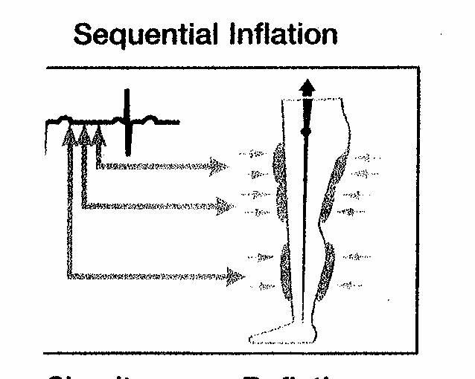
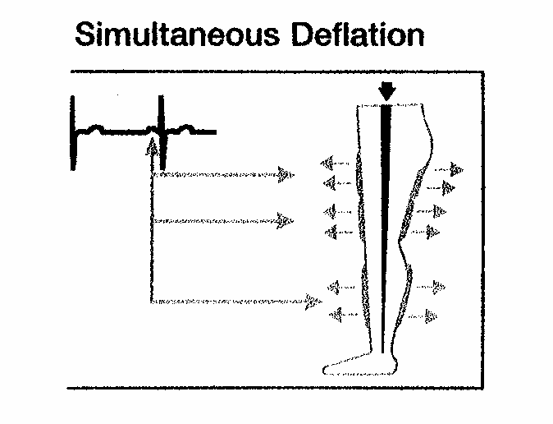

Slide 58
35 total treatments
5 days per week x 7 weeks
1 hour per day
reduce severity of angina
Indicated for CAD not amenable to revascularization
Beneficial in treatment of refractory CHF

Slide 59
Arrhythmias
Bleeding diathesis
Active thrombophlebitis & severe lower extremity vaso-occlusive disease
Presence of significant AAA
Pregnancy

Slide 60
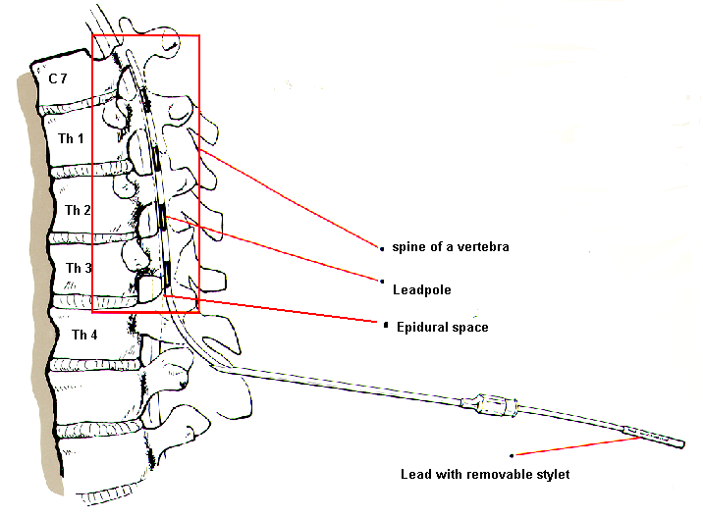
Spinal Cord Stimulation

Slide 61
EXERCISE
Anti atherosclerotic (improved lipid profile)
Anti thrombotic (decreased platelet adhesiveness, decreased fibrinogen, increased fibrinolysis, decreased blood viscosity)
Anti ischemic(decreased myocardial 02 demand, increased NO, increased CBF)
Anti arrhythmic( decreased adrenergic activity, increased vagal tone)

Slide 62
THANK YOU

Slide 63
1
ALL are fatty acid oxidation inhibitors except
1.Etomoxir
2.Oxfenicine
3.Ranolazine
4.Fasudil
5.trimetazidine

Slide 64
2
Major source of energy production in cardiomyocyte
Glycogen
Ketones
Free fatty acids
glucose

Slide 65
3
Oxygen consumption of heart during exercise(ml/min/100g)
60
70
80
90

Slide 66
4
Hemodynamic modulators include all except
1.Diltiazem
2.Amlodipine
3.Ranolazine
4.atenolol

Slide 67
5
In ischemia, false statement
1.Sodium overload
2.Calcium overload
3.Microvascular hypoperfusion
4.Decreased late sodium current

Slide 68
6
Trial not associated with RANOLAZINE
1.INITIATIVE
2.ASSOCIATE
3.VASCO
4.ALL OF THE ABOVE

Slide 69
7
Ranolazine , true statement
1.Increase HbA1C
2.Shortens QT interval
3.Decrease diastolic stiffness
4.Promotes late sodium current

Slide 70
8
Perhexilene S/E all except
1.Hepatotoxicity
2.Peripheral neuropathy
3.Hyperglycemia
4.All of the above

Slide 71
9
TRIMETAZINE S/E all except
1.RLS
2.EPS
3.Luminous phenomenon
4.None of the above

Slide 72
10
False match
1.IONA –NICORANDIL
2.ASSOCIATE-IVABRADINE
3.MERLIN TIMI – RANOLAZINE
4.TRIMPOL- PERHEXILINE

Slide 73
THANK YOU..

